Slide 1
WEEK
5
RECIPE RE-DO

Slide 2
Icebreaker
Have you tried any recipes that you learned here?
Have you used anything you have learned?
Are you planning to try anything?

Slide 3
ON THE MENU
SODIUM AND SALT
How Much?
Where Is It Hiding?
Read The Label
SPICE UP YOUR COOKING
Spices and Herbs
Flavour Boosters
Cooking Method
ADAPTING RECIPES
KNOWLEDGE CHECK
ACTIVITY TIME

Slide 4
SODIUM and SALT IN OUR BODY
Important for muscle contraction
Helps our body transmit nerve impulses
Helps maintain our bodies fluid balance

Slide 5
HOW MUCH?
Too much sodium can cause high blood pressure, stroke, heart disease and kidney disease.
Most North Americans get about 3400 mg per day!
<2400 mg
per day
= 1 to 1 ¼ teaspoons

Slide 6
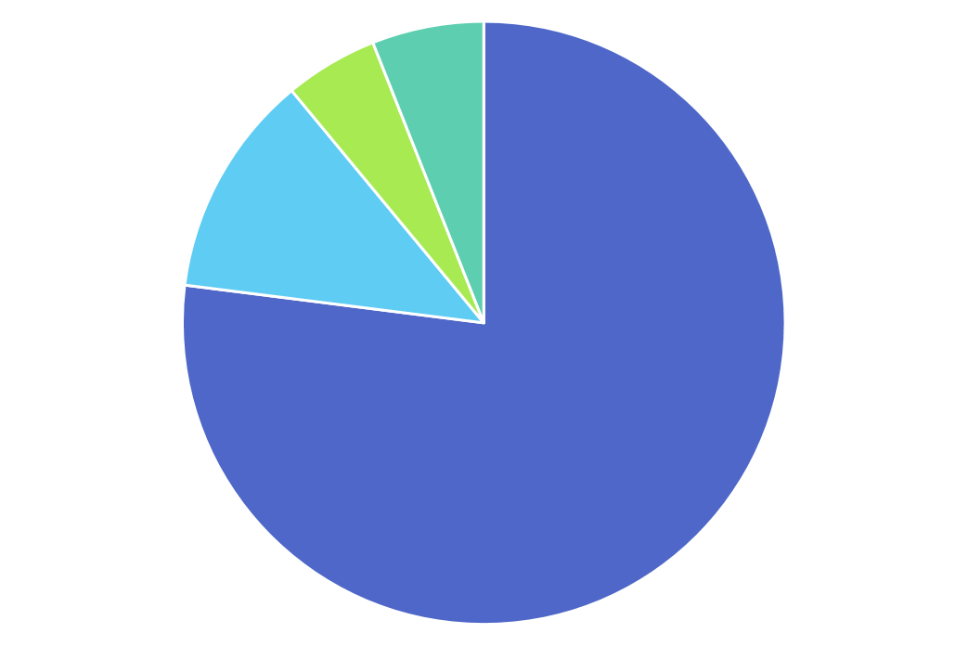
where IS IT hiding?
5% ADDED DURING COOKING
77% PROCESSED FOODS
6% ADDED AT THE TABLE
12% NATURALLY OCCURING

Slide 7
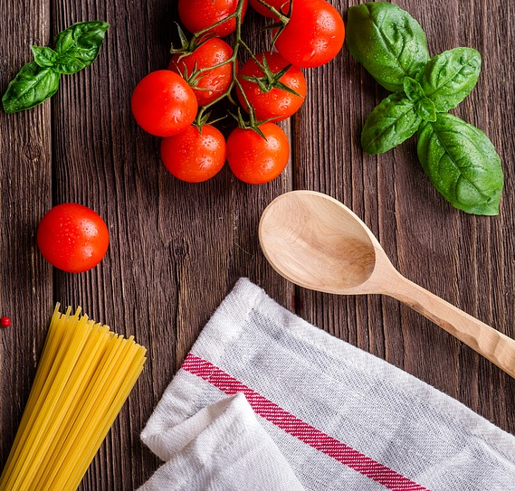
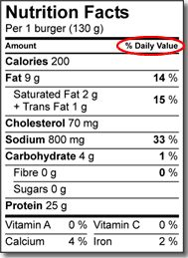
Read the label

Slide 8
Read the label REMEMBER %DV
LIMIT SODIUM
In Packaged Foods
200 mg or less
10 % or less Daily Value * remember 15% or more is A LOT!

Slide 9
SPICE UP YOUR COOKING

Slide 10
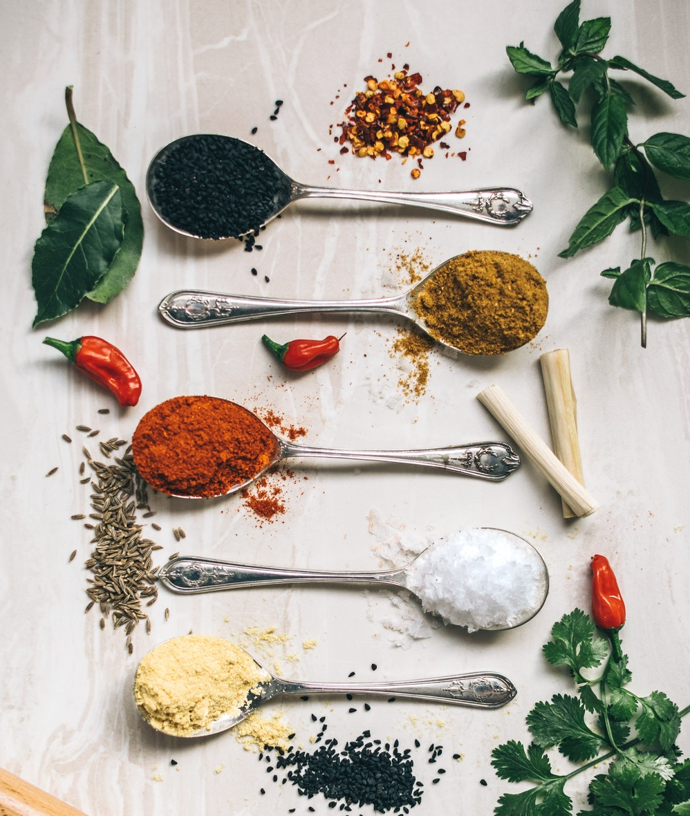
Spice up your cooking
SPICES AND HERBS
Ground cumin, chili powder, paprika, garlic powder
Herbs can add lots of flavor- use fresh OR dried!
Try mint, coriander/cilantro, parsley, dill

Slide 11
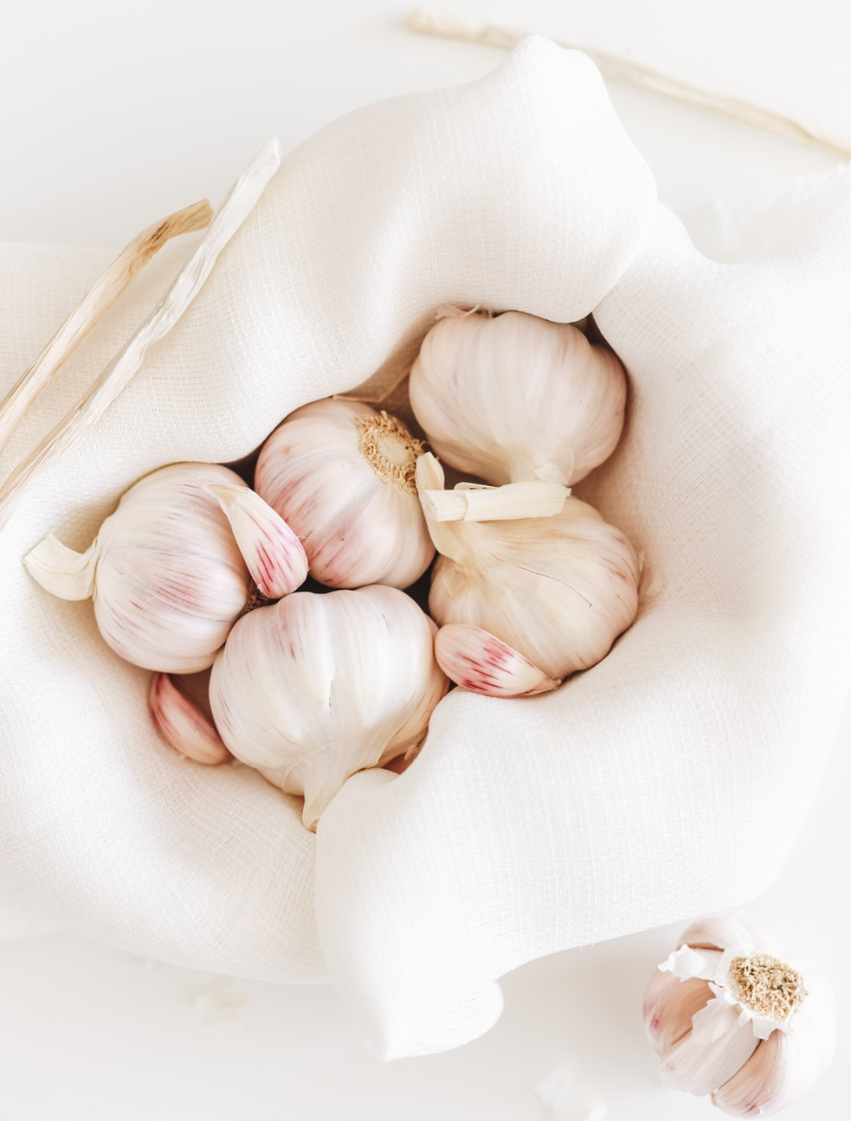
Spice up your cooking
FLAVOUR BOOSTERS
Spices and herbs aren’t the only way!
Use broth instead of water when making soup or boiling rice
Add acids (lemon or vinegar), garlic, and onions while cooking

Slide 12
Spice up your cooking
COOKING METHOD
Cook your food differently!
Steaming: less flavor
Roasting, Braising, Sautéing: MORE flavor
Think about a slice of plain bread, and then a slice of toasted bread! Which one tastes better?
*add a couple teaspoons of oil to add more flavour while you cook your food

Slide 13
Adapting Recipes
1 cup whole wheat flour
½ ¼ cup sugar
½ tsp baking soda
1 tsp baking powder
2 ripe mashed bananas

Slide 14
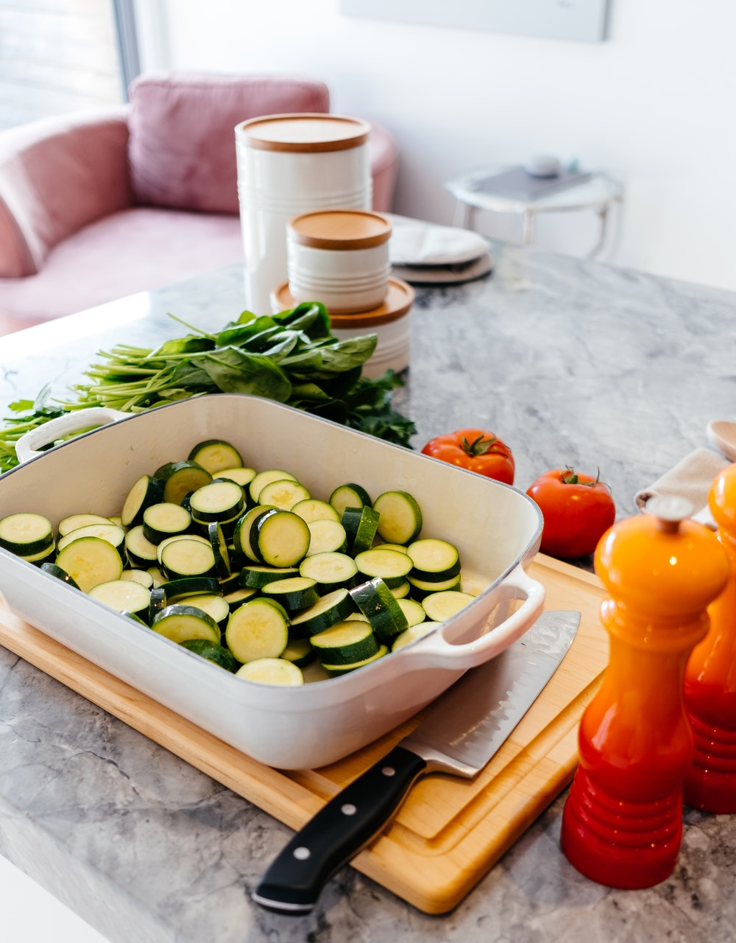
Adapting Recipes vegetables and FIBRE
ADD MORE VEGGIES
BAKE WITH VEGGIES + FRUIT
Try adding grated carrots, zucchini, or pumpkin puree to your muffins or cakes
This adds moisture, fibre, and nutrients!
Use mashed banana or apple sauce to replace some of the fat or sugar!
You can usually replace ¼ of the fat or sugar!
DOUBLE the vegetables in your recipe
If the recipe calls for 1 diced carrot, add 2!
ADD some spinach to your smoothie, pasta sauce, or in your stew
Spinach practically disappears when you add it to things!
HIDE: puree or grate vegetables into soups or sauces
Grated carrots, finely chopped mushrooms, peppers

Slide 15
Adapting Recipes GRAINS and FIBRE
USE WHOLE GRAINS
Flour: Replace white or all-purpose flour with whole wheat when baking
Pasta: Try whole wheat pasta instead of regular
Rice: Try brown rice or mix in
other whole grains like quinoa
or barley
BEANS PEAS AND LENTILS
Chickpeas, black beans, kidney beans
Try adding these to your dishes – they work great in chilies, soups, stews

Slide 16
Adapting Recipes SWAP SUGARS
SWAP ¼ of the sugar in a recipe for a different type of sugar
E.g. if recipe calls for 1 cup of sugar: use ¾ cup and swap the other ¼ cup
1 mashed banana
¼ cup apple sauce
¼ cup dried fruit)
You can DECREASE the sugar in most recipes by at least ¼ without making any other changes! E.g. if a recipe calls for 1 cup of sugar, try using only ¾ cup

Slide 17
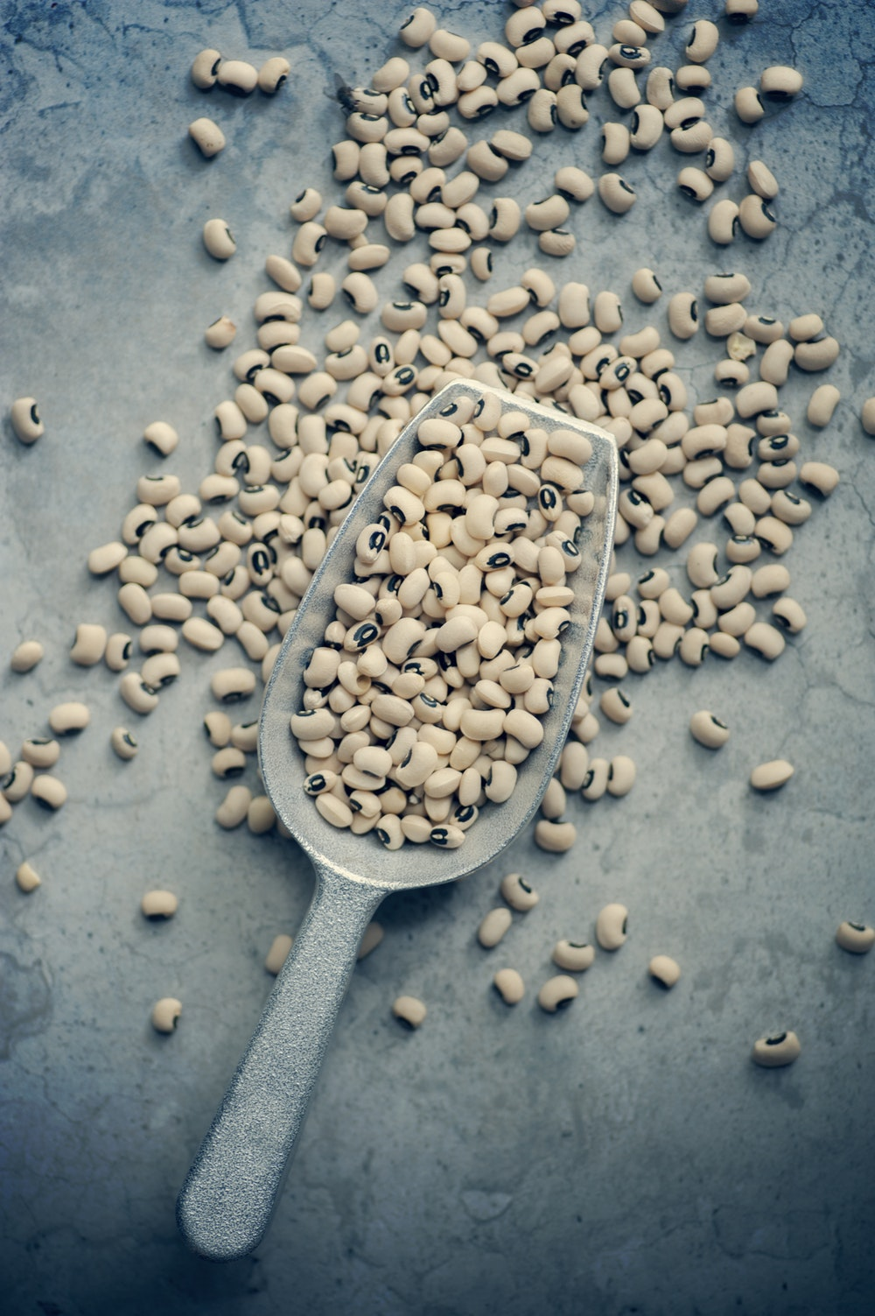
Adapting Recipes FATS, PROTEIN, DAIRY
Replace the Fat Swap ½ of the oil or butter in baked goods with:
Apple sauce or banana
Yogurt
Mashed avocado
Try using unsaturated fat instead of saturated
Use oils (canola or vegetable)
Lean Meats, or Fish Substitute the protein in your recipe:
Use ground chicken instead of beef
Choose extra lean
Plant Protein
Tofu, Beans, Lentils
Add beans or lentils to chili or soups
Use tofu instead of animal protein in a stir fry
Milk and Alternatives
Try Greek yogurt instead of sour cream
Control your portion size of cheese
Use milk instead of cream

Slide 18
KNOWLEDGE CHECK
1
2
3
LIMIT SODIUM
ADD FLAVOUR
ADAPT
1
Swap/Decrease Sugars
HERBS AND SPICES
2
<200mg
<10% DV
Add Fibre (whole grains)
ACIDS, SAUCES, BROTH
3
Add MORE Vegetables!
COOKING METHOD
4
Minimize Fat (look for lean and low fat)

Slide 19
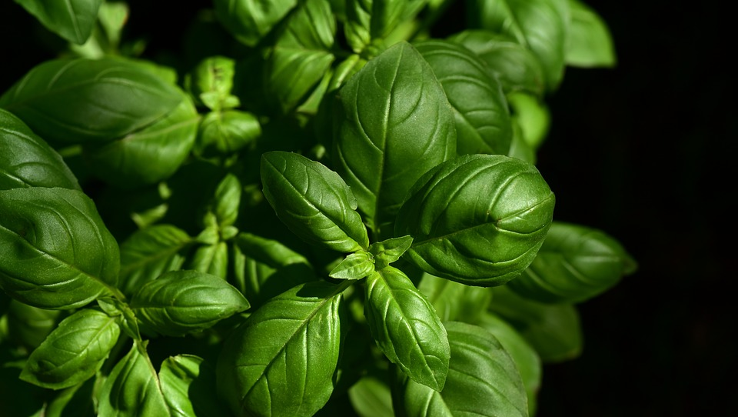
ACTIVITY TIME!
FILL OUT YOUR HANDOUT!

Slide 20
where IS IT hiding?
5% ADDED DURING COOKING
77% PROCESSED FOODS
6% ADDED AT THE TABLE
12% NATURALLY OCCURING

Slide 21
BANANA MUFFINS
Ingredients | NEW Ingredients
2 1/2 cups (625 mL) all-purpose flour
1 cup (250 mL) packed brown sugar
1-1/2 tsp (7 mL) baking powder
1 tsp (5 mL) baking soda
1/2 tsp (2 mL) salt
2 eggs
1 cup (250 mL) milk
1 cup (250 mL) mashed bananas
1/3 cup (75 mL) butter
1 tsp (5 mL) vanilla
3/4 cup (175 mL) chocolate chips
2 1/2 cups (625 ml) whole wheat flour
3/4 cup (175 ml) packed brown sugar
1 1/2 cups (375 ml) mashed bananas
1/4 cup (75 ml) oil
1/2 cup (125 ml) chocolate chips

Slide 22
SPAGHETTI AND MEATBALLS
Ingredients | NEW Ingredients
2 tbsp (25 mL) extra-virgin olive oil
2 onions, finely chopped
3 cloves garlic, minced
1 egg
2 tsp (10 mL) fennel seeds, crushed
1 tsp (6 mL) salt
3/4 tsp (4 mL) pepper
1 cup (250 mL) fresh bread crumbs
1/4 cup (50 mL) minced fresh parsley
1/4 cup (50 mL) grated Parmesan cheese
16 oz (500 g) ground beef
1/2 cup (125 mL) chicken stock
1 can (28 oz/796 mL) diced tomatoes
1-1/2 cups (375 mL) crushed canned tomatoes
1/2 cup (125 mL) coarsely chopped fresh basil (or 2 tsp/10 mL dried)
1/4 tsp (1 mL) granulated sugar
1-1/2 lb (750 g) spaghetti
BONUSDid you add any veggies?
1 cup whole wheat bread crumbs
16 oz extra lean ground beef OR chicken​
1 can low sodium chicken stock
1 can low sodium diced tomatoes
1 1/2 cups low sodium canned crushed tomatoes
why do you need sugar?
1-1/2 lb whole wheat spaghetti
use ½ and ½ whole wheat spaghetti and spiralized zucchini!

Slide 23
Thank you to our sponsor
Canada’s Children’s Hospital Foundations (CCHF) is grateful for Sun Life Financial’s $2 million commitment to support the creation of Meant2Prevent: A type 2 diabetes prevention initiative for children and youth presented by Sun Life. As part of Sun Life Financials’ Team Up Against Diabetes platform, this partnership allows the children’s hospital network of experts to positively influence children and youth to live healthier lives through awareness and education. Thank you Sun Life Financial for your dedication to building sustainable, healthier communities and families by helping to prevent type 2 diabetes.

Slide 24
This project is part of
www.Meant2Prevent.com
www.Meant2PreventKitchen.com

